Slide 1
Rail Transport
Combined Transport

Slide 2

How do I work with this learning material?
PowerPoint slides
The following PowerPoint presentation contains fundamental and in-depth content about rail transport. For further information the notes briefly describe the contents of each slide and the sources used.
Reader
Additionally, a detailed reader doubling as a script is provided.
Links
The sources used for the presentation are provided in the learning packages in a link collection.
Videos
Videos are provided in the relevant learning packages.

Slide 3
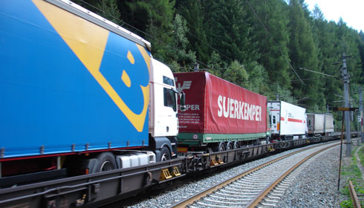

Introduction
Trucks on rails?
A rolling road?
Notes:
Video: ROLA Trailer Ökombi rolling road Brenner https://www.youtube.com/watch?v=cElzfwNNM_4
Image: Rola (2016), online

Slide 4
Agenda
Transport Processes
Combined Transport (CT)
Unaccompanied CT (UCT)
Accompanied CT

Slide 5
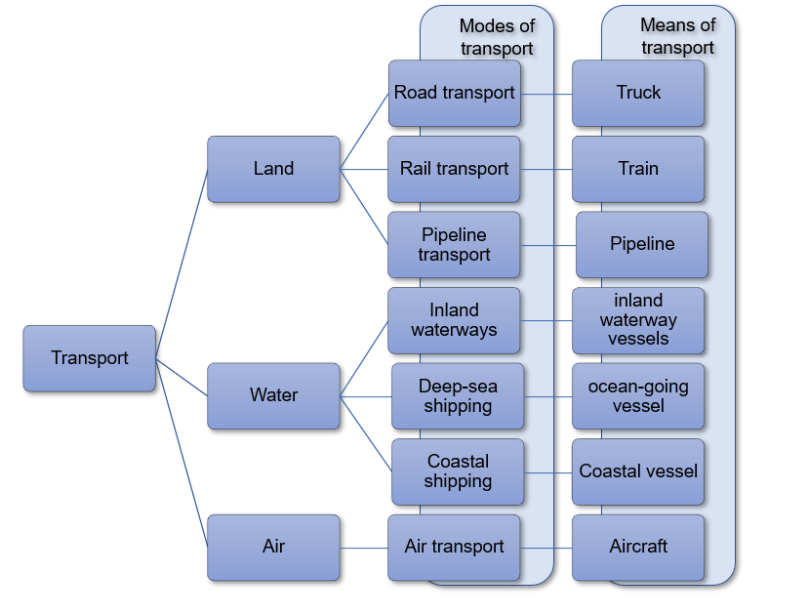
Transport
Means of transport: vehicle used for transporting passengers and goods (rail, inland waterway, truck, etc.).
Mode of transport: infrastructure for the use of means of transport (such as road, rail, waterway,...)
Notes:
External transport deals with the transport of materials or goods outside the company and is carried out by means of transport using modes of transport. There are different types of modes of transport. A mode of transport offers the infrastructure that must be available for the use of a particular mode of transport. Means of transport are vehicles and equipment for carrying people and goods, such as inland waterway vessels, trucks or trains. No transport is possible without this infrastructure. The modes of transport can be on land, on water and in the air. Land transport includes road, rail and pipeline transport, for example. Air includes the means of cargo aircraft and water transport includes inland waterways, ocean transport and coastal shipping.
See Dolinsek et al., 2013, p. 174f, Kummer (2010), p. 56 ff.

Slide 6
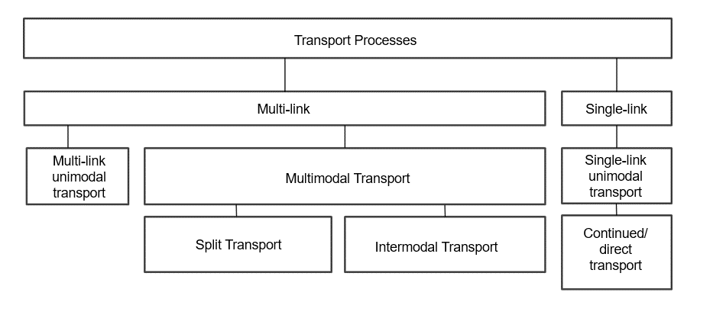
Transport Processes
Notes:
In the figure a distinction is made between multi-link and single-link transport processes in the first step. While goods are transhipped in multi-carriage transport, no transhipment takes place in single-carriage transport. Direct transport (single-link transport chain) takes place directly from the delivery point to the receiving point, which is why it is also referred to as door-to-door transport. No change of means of transport (e.g. truck, train, ship) or mode of transport (e.g. rail or inland waterway) is made. Therefore, direct transport is always unimodal (goods are transported by one means of transport from source to destination). Examples of this are port-port transport by inland waterway (e.g. transport of mineral oil from warehouse A to warehouse B).
In multimodal transport, goods are transported using two or more different modes of transport (e.g. switching from water to rail). The goods are transferred from one means of transport to another. The positive properties of the respective carrier can be used and the most cost-effective and environmentally friendly combination can be selected. Multimodal transport tends to be used for longer and less time-sensitive transports, as time is lost with each transhipment and additional costs incur.
See Dolinsek et al., 2013, p. 175f, Kummer (2010), p. 56 ff.

Slide 7
Intermodal Transport
intermodal transport
combined transport (CT)
other intermodal transport
unaccompanied CT (UCT)
accompanied CT
roll-on / roll-off
rolling road (German: ROLA)
container
swap bodies
craneable semitrailer
Notes:
Intermodal transport refers to the "transport of goods in one and the same loading unit or road vehicle by two or more modes of transport, with a change of loading unit but no transhipment of the transported goods themselves".
Source: UN/ECE (2011), p.17
In intermodal transport, loading units are transported from various sources to the transhipment point where the main leg starts. This process represents the preprocessing. All delivered loading units are transshipped at the terminal onto the corresponding main leg carrier (transshipment process). In most cases this is rail or inland waterway. This mode of transport takes over the major part of the transport route to another terminal (main run). Here again a transhipment takes place for the transport to the destination (on-carriage).
The main advantage of intermodal transport is the concentration of traffic flows on a more environmentally friendly mode of transport.
Cf. Gronalt et al (2010), p. 19
Combined transport is thus defined as "intermodal transport, in which the majority of the distance travelled in Europe is covered by rail, inland waterway or sea, and the pre- and post-carriage by road is kept as short as possible".
Source: UN/ECE (2011), p.18

Slide 8
Agenda
Transport processes
Combined transport (CT)
Unaccompanied CT (UCT)
Accompanied CT

Slide 9
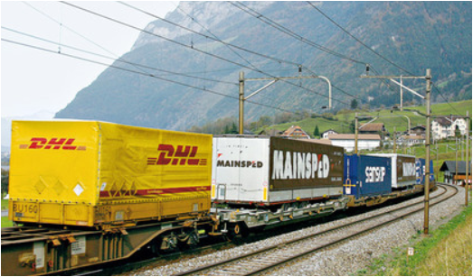
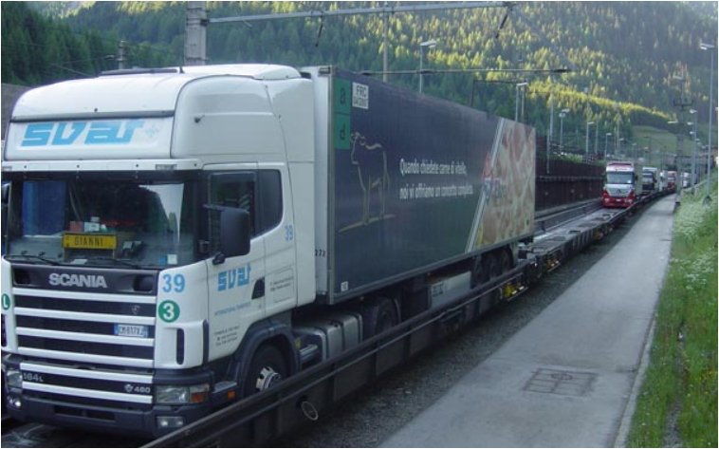
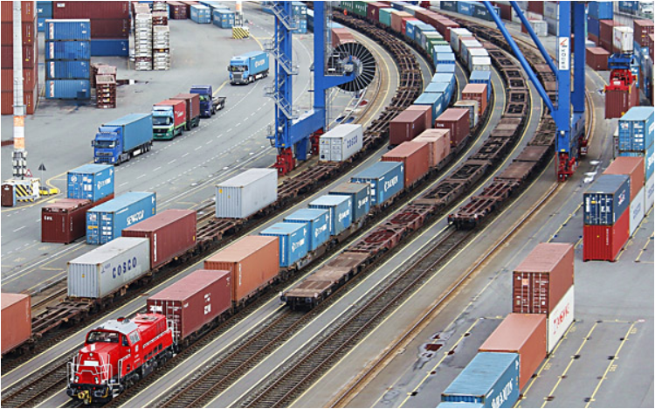
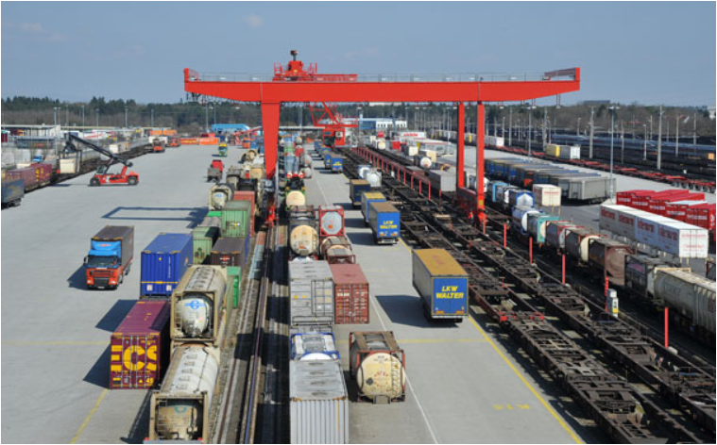
Combined Transport
Notes:
Combined transport is characterised by transport chains in which standardised loading units, such as containers, swap bodies, lorries or their trailers are carried successively on different modes of transport. When changing modes of transport in terminals, only the loading units are handled, i.e. the goods remain in the same transport container during the entire transport.
The loading units (e.g. containers, swap bodies) are usually carried individually between the place of dispatch and the point of transshipment (pre-carriage) or point of transshipment and point of receipt (post-carriage). The main leg is the distance between the transshipment points (e.g. transshipment terminal).
Another characteristic of combined transport is that the main leg is covered by an environmentally friendly means of transport, e.g. by rail, but also by inland waterway or sea, while the pre- and post-carriage by road is kept as short as possible.
See Kummer (2010), p. 57; Becker (2014), p. 39f; Forschungsinformationssystem (2016), online.
Combined transport is thus defined as "intermodal transport, in which the majority of the distance travelled in Europe is covered by rail, inland waterway or sea, and the pre- and post-carriage by road is kept as short as possible".
Source: UN/ECE (2011), p.18
Images: DVZ (2017), online; Verkehrsrundschau (2013), online; Verkehrsrundschau.de (2014), online.
Verkehrsrundschau.de (2015), online.

Slide 10
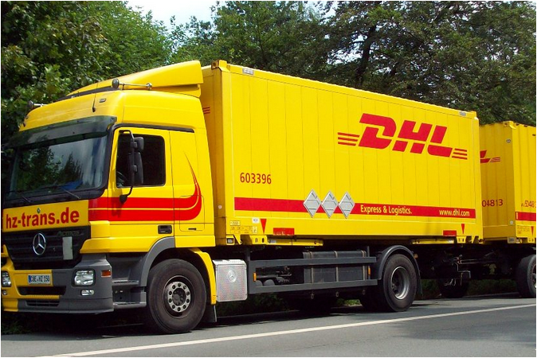
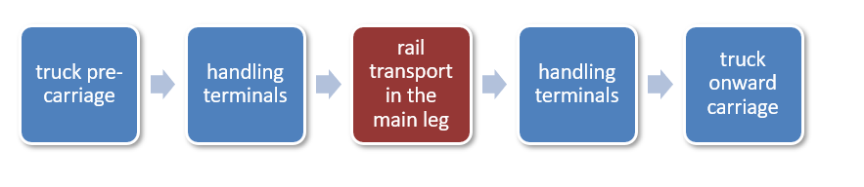
Combined Transport
Transport Chain
Notes:
Truck transports over long distances are transferred from road to rail by means of combined transport, i.e. truck pre-carriage or truck post-carriage usually only takes place over short distances.
Between handling terminals, transport containers are carried by rail in the main leg, usually corresponding to longer distances.
Increased logistical effort is a challenge for combined transport, which on the one hand results in costs for truck pre-carriage or truck post-carriage and on the other, in transhipment processes and loss of time as a result of the transhipment processes.
Cf. Becker (2014), p. 40
Images: DVZ (2017), online; vehicle images (2017), online; Verkehrsrundschau (2015), online.

Slide 11
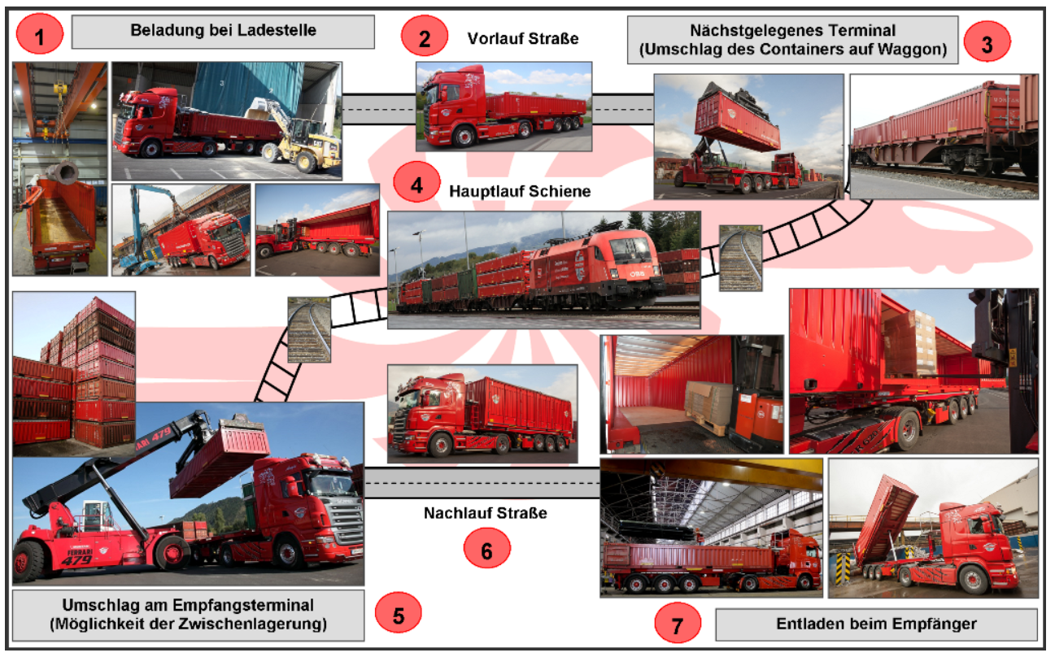
Unaccompanied Combined Transport (UCT)
Loading at loading point
Truck pre-carriage
Handling Terminal
Rail in the main leg
truck onward carriage
Handling Terminal
Unloading at recipient
Notes:
In unaccompanied combined transport (UCT), only the loading units are transferred from one mode of transport to another and carried onward. Driver and vehicle do not accompany the transport and are available for other tasks. At the destination of the main leg, e.g. at a transhipment terminal, suitable trucks and drivers must therefore be available for onward transport. The figure above illustrates the process flow in UCT.
The most important transport units used in UCT are:
containers
swap bodies and
craneable semi-trailers.
Source: Gronalt et al (2010), p. 20 f.
Image: Montansped (2017), online.

Slide 12
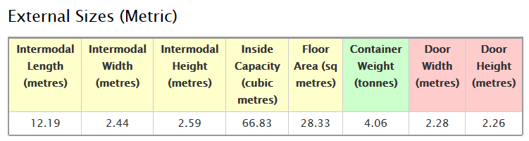
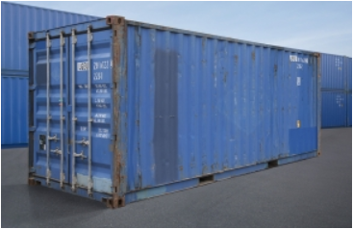
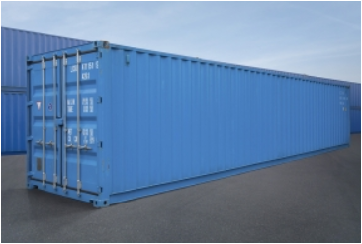
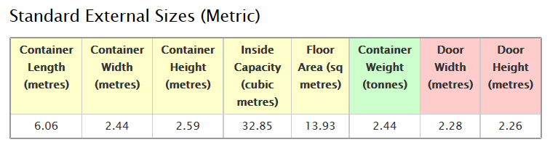
Transport Unit: Containers I
20 foot container
40 foot container
Notes:
The container first gained importance at the beginning of the 1950s. Until today the American origin is reflected in the measurements in foot ( ´ ). Advantages of the container are its standardization, robustness and resulting stackability. Its primary disadvantage is incompatibility with Euro pallets, but also the fact that the container can only be parked on the ground, making loading and unloading frequently difficult.
According to ISO-Norma the container (International Standardisation Organisation) is the best known loading unit, with the vast majority of containers having a length of 20 or 40 feet. Their dimensions are primarily oriented towards seagoing vessels.
The internal dimensions of ISO containers do not permit optimum use of cargo space with Euro pallets widely used in Europe (use of the internal surface area for 20-foot containers: 78%, for 40-foot containers: 85%).
An inland container (according to UIC standard) is a container which has been adapted to European dimensions. With a width of up to 2.55 metres, they correspond to the maximum legal width of road vehicles and the loading gauge of the railways. Thus, they adapt better to the conditions of European infrastructure and are much more suitable for loading Euro pallets than sea containers with an internal width of 2,420 to 2,440 millimetres.
See Gronalt et al (2010), p. 51ff.
Dimensions: Shippingcontainers (2017), online.
Images: Carucontainers (2017), online.

Slide 13
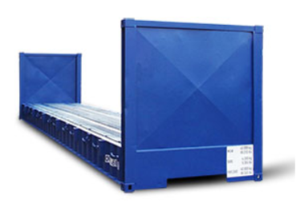
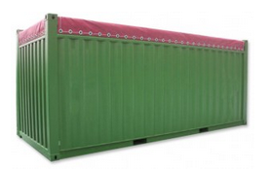
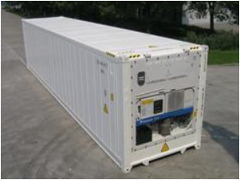
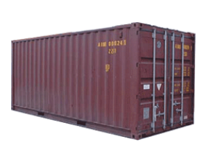
Transport Unit: Containers II
flat container
open top container
high cube container
refrigerated container
Notes:
Flat containers are used for particularly heavy goods, available in a variety of designs, e.g. with fixed or foldable end walls, with floors of different heights, etc.
Open Top Containers are open at the top and are therefore suitable for transporting goods that are insensitive to weather conditions. They can be covered with nets or tarpaulins.
High Cube containers are suitable for specifically light but voluminous goods, whose structure resembles standard containers but which are built slightly higher.
Refrigerated containers ("reefers") are equipped with their own electrical unit, thus enabling transport of temperature-controlled goods.
See Gronalt et al (2010), p. 53ff.
Images: Shippingcontainers (2017), online.

Slide 14
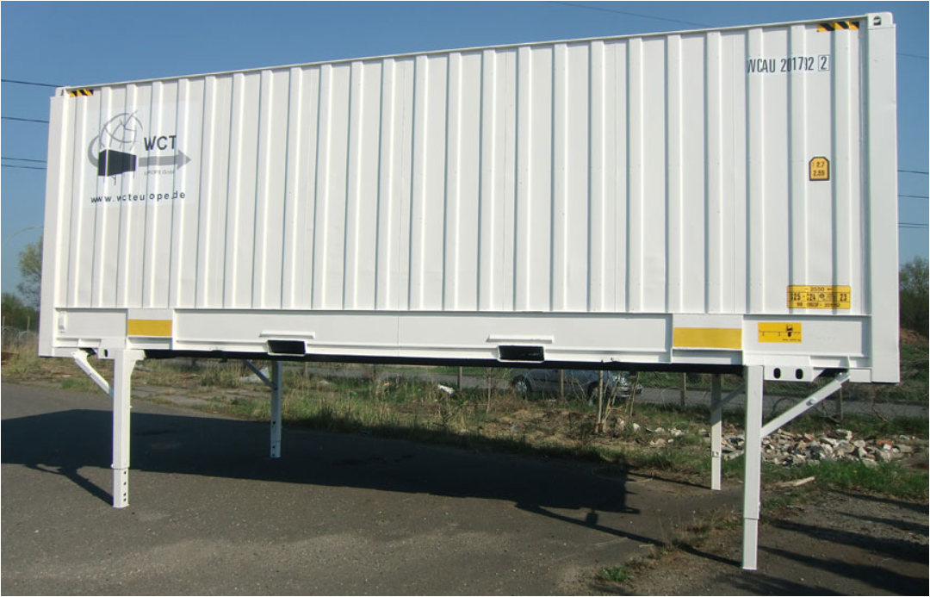
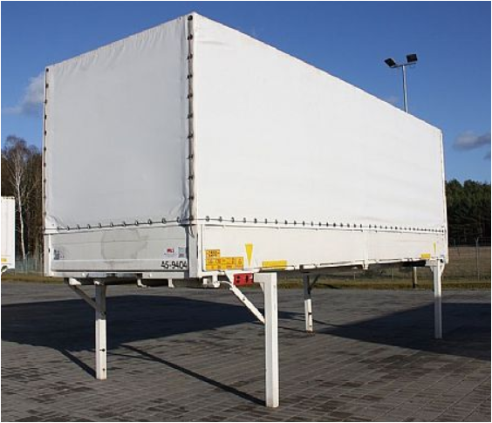
Transport Unit: Swap Body
swap body in box design
swap body tarpaulin structure
Notes:
A swap body is an exchangeable load carrier which can be separated from the carrier vehicle, e.g. truck. Their development was influenced by the European road haulage industry. Therefore, Euro pallets are usually fully operational.
Other terms for swap bodies are: swap body, swap trailer, demount body.
A basic distinction can be made between "box bodies" (made of wood or metal) and tarpaulin bodies, whereby the tarpaulins are usually kept in shape by so-called "hoops" made of wood or light metal.
For use in combined transport, the swap body is equipped with gripping edges located on the underside, enabling transhipment by rail. For this purpose, cranes at the container terminals have special grab arms to enclose and lift swap bodies laterally.
Swap bodies cannot be used in overseas traffic as they are neither centrally standardised nor registered. They are rarely stackable and do not have the required strength for torsional forces during sea transport. On the other hand, they are usually equipped with adjustable feet so that they are positioned at ramp height making loading and unloading easier than ISO containers.
Cf. Gronalt et al (2010), p. 56
Images: Conzept (2017), online

Slide 15
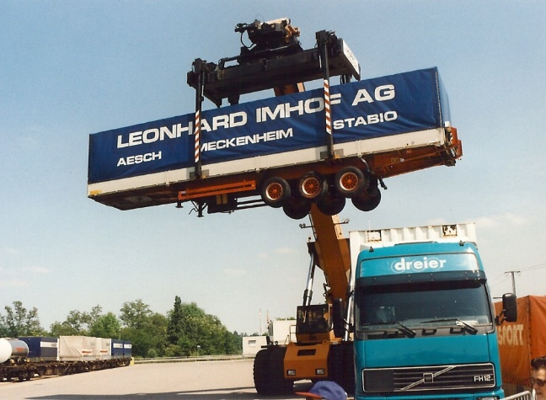
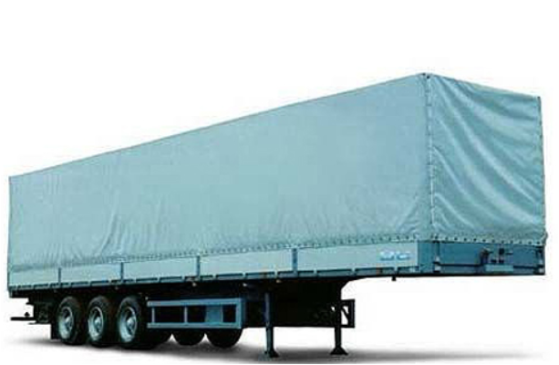
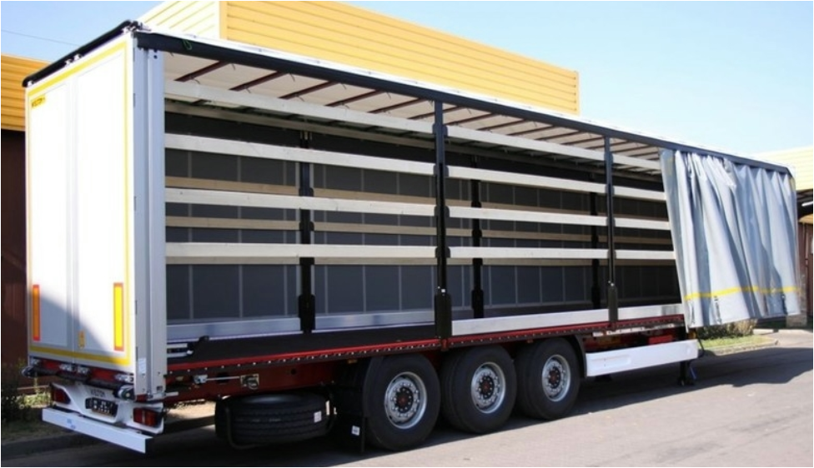
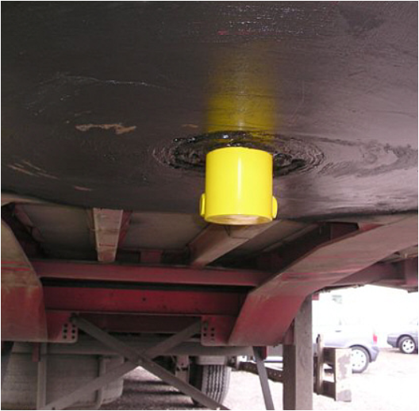
Transport Unit: Semitrailer
semitrailer
craneable semitrailer
kingpin
laterally open semi-trailer with sliding tarpaulin
Notes:
Semi-trailers are special truck trailers which are not attached to the towing vehicle by a drawbar, but are hooked by king pins into a recess in the chassis of the truck towing vehicle.
Craneable semi-trailers can be used in both accompanied and unaccompanied combined transport, non-craneable semi-trailers, with a few exceptions, can only be used in accompanied combined transport (rolling road).
See Gronalt et al (2010), p. 58 ff.

Slide 16
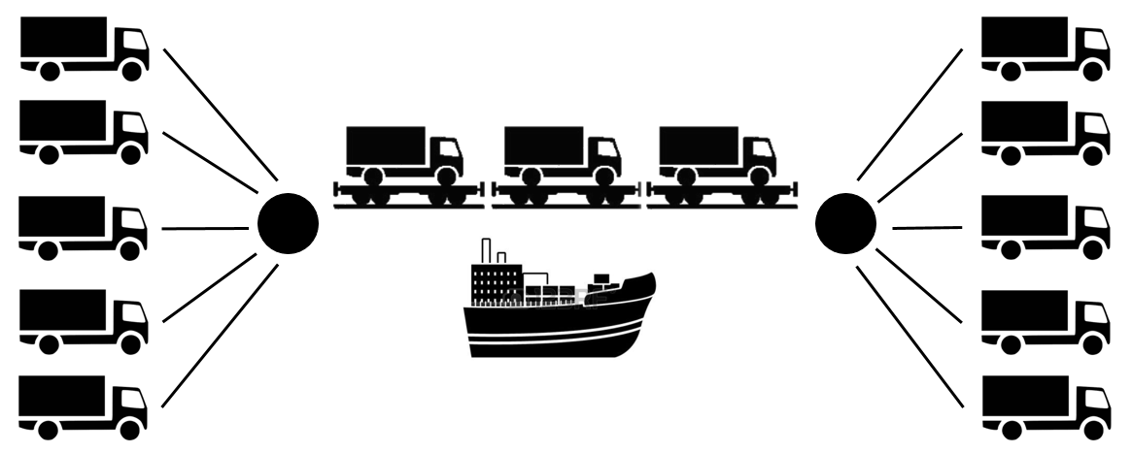
Accompanied Combined Transport
Notes:
In accompanied CT, trucks with trailers or articulated vehicles (articulated lorries and semi-trailers) are mainly loaded onto low-floor wagons at the terminals provided for this purpose in rail transport. Accompanied road - ship combined transport may also be possible, although road - ship combined transport is usually unaccompanied.
Cf. Gronalt et al (2010), p. 22

Slide 17
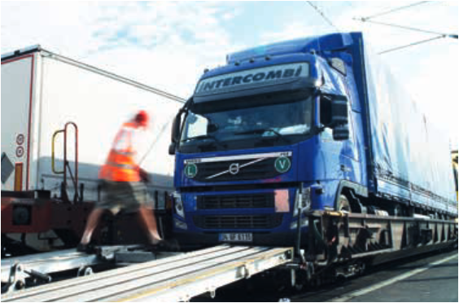
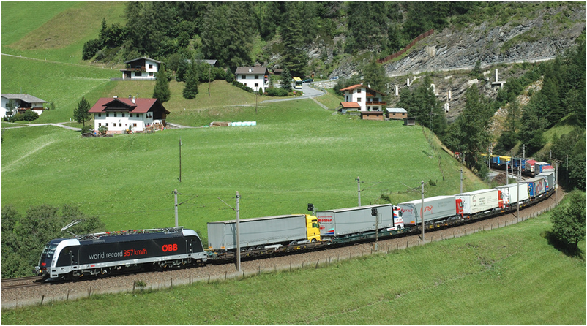
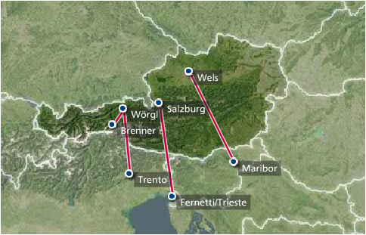
Rolling Road/Highway
(German: ROLA)
Rolling Road (German: ROLA) lines of Rail Cargo Austria
Notes:
If a truck with tractor unit and semi-trailer or trailer is completely transported by rail (on low-floor or pocket wagons) and the truck driver drives in the couchette rail car, this is referred to as the "Rolling Road/Highway". For all other CT transports, transport is by rail without staff assistance.
If the efficiency of CT is to be assessed, the relationship between payload and deadload must be taken into account. While, for example, the weight of the tractor and trailer of the rolling road is very high in relation to the carried weight of goods, this ratio is relatively favourable for swap bodies.
Cf. Becker (2014), p. 14
Advantages of the rolling road:
Reduction of fuel and operating kilometres
Vehicle tax refund, toll and special toll savings
Avoidance of night driving bans and speed limits to 60 km/h at night
Adherence to driver rest periods without transport interruption
Avoidance of congestion waiting times
Positive public image through reduced carbon footprint
See Rail Cargo (2017b), online.
Images: Rail Cargo (2017a), online; Rola (2016), online, Rail Cargo (2017c), online.

Slide 18
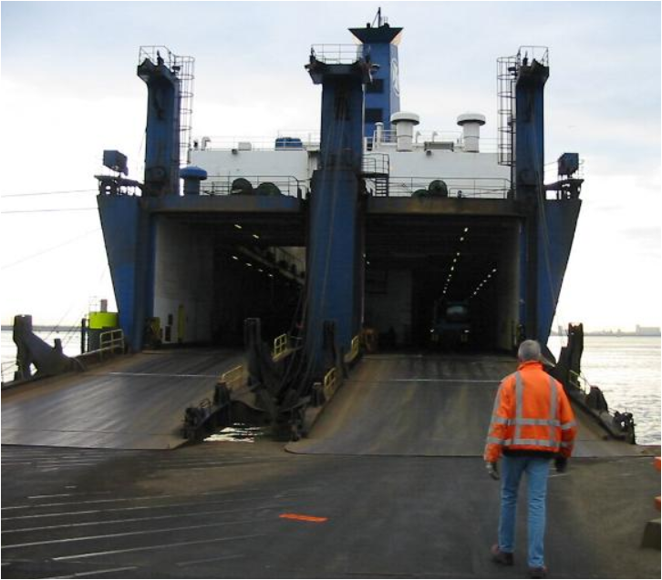
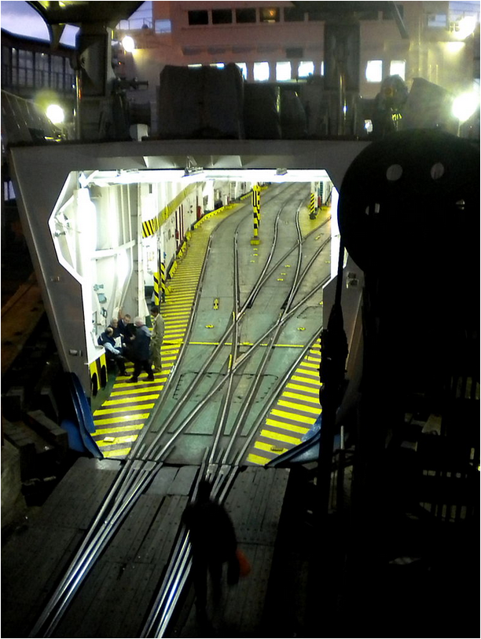
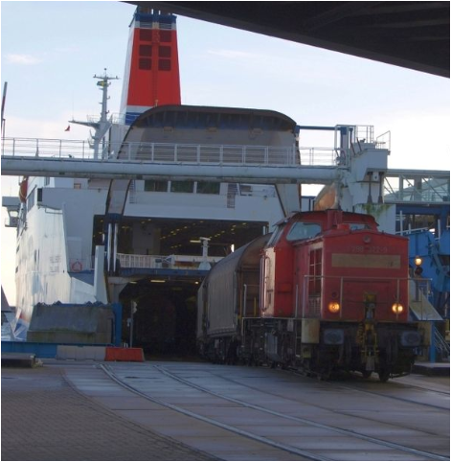
Roll-on / Roll-off
RoRo ship
rail ferry
unloading
Notes:
Roll-on-Roll-off (RoRo) means the loading and unloading of a motor vehicle or railway wagon onto or from a ship, using its own wheels or wheels which have been placed under cover for this purpose. In most cases this constitutes unaccompanied combined transport.
See Gronalt et al (2010), p. 21f.

Slide 19
List of References
Becker, K. G. (Hrsg., 2014): Handbuch Schienengüterverkehr, Hamburg: DVV Media Group Eurorailpress
Carucontainers (2017): http://www.carucontainers.com/de/container/seecontainers/40ft-container/40ft-standard-container (30.1.2017)
Conzept (2017): http://www.conzept.at/mietcontainer/wechselbehaelter (30.1.2017)
Dolinsek, M., Hartl, S., Hartl, T., Hintergräber, B., Hofbauer, V., Hrusovsky, M., . . . Slavicek, D. (2013). Handbuch der Donauschifffahrt. Vienna: viadonau
DVZ (2017): http://www.dvz.de/rubriken/landverkehr/single-view/nachricht/hoeher-machen-statt-tiefer-legen.html (21.1.2017)
Economica Institut für Wirtschaftsforschung (Hrsg., 2013): Schienengüterverkehr: Markt- und Wettbewerbssituation, Wien, in: http://www.esce.at/eco3/wp-content/uploads/2016/04/2013-Schieneng%C3%BCterverkehr-Markt-und-Wettbewerbssituation-Folder.pdf
Fahrzeugbilder (2017): http://www.fahrzeugbilder.de/name/galerie/kategorie/LKW~Mercedes-Benz~Wechselbrucke/digitalfotografie/24.html (21.1.2017)
Gronalt, M. / Höfler, L. / Humpl, D. / Käfer, A. / Peherstorfer, H. / Posset, M. / Pripfl, H. / Starkl, F. (2010): Handbuch Intermodaler Verkehr, Wien: Bohmann
Forschungsinformationssystem (2016): in: http://www.forschungsinformationssystem.de/servlet/is/306087/ (21.12.2016)
Kummer, S. (2010): Einführung in die Verkehrswirtschaft, 2. Auflage, Wien: Facultas
Kummer, S., Grün, O., & Jammernegg, W. (2009). Grundzüge der Beschaffung, Produktion und Logistik. Pearson Studium
Montansped (2017): http://www.montansped.com/index.php/de/leistungen/kombinierter-verkehr (30.1.2017)
Rail Cargo (2017a): http://www.leitbetriebe.at/de/leitbetriebe/?mode=detail&id=3645e428-22f8-155f-5b47-4f9410a88b45#wrap-content (21.1.2017)
Rail Cargo (2017b): http://www.railcargo.com/de/Operator/ROLA/index.jsp (30.1.2017)
Rail Cargo (2017c): http://www.railcargo.com/de/E-Services/Infothek/Publikationen/factsheets_operator.pdf (31.1.2017)
Rola (2016): https://www.rola.at/ (22.12.2016)
Shippingcontainers (2017): http://www.shippingcontainers24.com/types/ (30.1.2017)
UN/ECE (2001): Terminologie des kombinierten Verkehrs, in: http://www.unece.org/fileadmin/DAM/trans/wp24/documents/term.pdf
Verkehrsrundschau.de (2013): http://www.verkehrsrundschau.de/kombinierter-verkehr-sgkv-beraet-bmvbs-1194981.html (21.12.2016)
Verkehrsrundschau.de (2014): http://www.verkehrsrundschau.de/oesterreich-gegensaetzliche-nachfrage-nach-rollender-landstrasse-1364356.html (21.12.2016)
Verkehrsrundschau.de (2015): http://www.verkehrsrundschau.de/oesterreich-rail-cargo-group-organisiert-terminalbetrieb-neu-1705563.html (21.12.2016)

Slide 20

Additional Information
We hope our PowerPoint presentation meets your requirements!
- You are welcome to adapt the set of slides according to your wishes and requirements and to use it for your lessons/lectures.
Please email your questions or feedback to rerail@fh-vie.ac.at .
Further PowerPoint slides and teaching materials at:
http:///www.retrans.at/de/

